Slide 1
BOOTSTRAP

Slide 2

¿Qué es?
Es un framework desarrollado por Twitter en 2010 que combina JS y CSS para estilizar las páginas HTML de manera rápida y de una manera responsive.

Slide 3
Instalación
- En el head →
<link href="https://cdn.jsdelivr.net/npm/bootstrap@5.1.1/dist/css/bootstrap.min.css" rel="stylesheet" integrity="sha384-F3w7mX95PdgyTmZZMECAngseQB83DfGTowi0iMjiWaeVhAn4FJkqJByhZMI3AhiU" crossorigin="anonymous">
Al final del body →
<script src="https://cdn.jsdelivr.net/npm/@popperjs/core@2.9.3/dist/umd/popper.min.js" integrity="sha384-W8fXfP3gkOKtndU4JGtKDvXbO53Wy8SZCQHczT5FMiiqmQfUpWbYdTil/SxwZgAN" crossorigin="anonymous"></script>
<script src="https://cdn.jsdelivr.net/npm/bootstrap@5.1.1/dist/js/bootstrap.min.js" integrity="sha384-skAcpIdS7UcVUC05LJ9Dxay8AXcDYfBJqt1CJ85S/CFujBsIzCIv+l9liuYLaMQ/" crossorigin="anonymous"></script>
Bootstrap

Slide 4
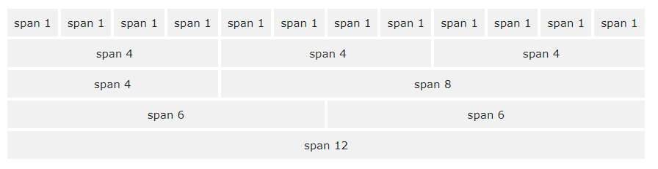
Grid Basic
Flexbox → 12 columnas en total → Responsive

Slide 5
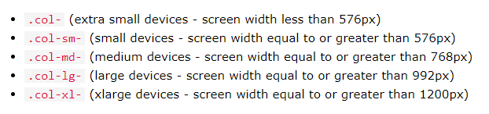
Grid Basic
5 clases. Se adaptan al tamaño de la pantalla.
Son escalables. Si se quiere establecer medidas para sm y md, sólo se tiene que establecer sm.

Slide 6
Grid Basic
3 columnas con el mismo ancho. 3 columnas iguales.
<div class="row"> <div class="col">.col</div> <div class="col">.col</div> <div class="col">.col</div> </div>
No especificamos el tamaño (sm|md|lg|xl) ni las medidas. Para todos los dispositivos. Se ajusta.

Slide 7
Grid Basic
4 columnas con el mismo ancho. Tenemos en cuenta que el total son 12.
<div class="row"> <div class="col">.col</div> <div class="col">.col</div> <div class="col">.col</div> </div>
El tamaño se ajustará desde dispositivos sm hasta dispositivos mayores.

Slide 8
Grid Basic
4 columnas con el mismo ancho. Tenemos en cuenta que el total son 12.
<div class="row"> <div class="col-sm-3">.col-sm-3</div> <div class="col-sm-3">.col-sm-3</div> <div class="col-sm-3">.col-sm-3</div> <div class="col-sm-3">.col-sm-3</div> </div>
El tamaño se ajustará desde dispositivos sm hasta dispositivos mayores.

Slide 9

Grid Basic
2 columnas. La de la derecha ocupa 2/3. Tenemos en cuenta que el total son 12.
<div class="row"> <div class="col-sm-4">.col-sm-4</div> <div class="col-sm-8">.col-sm-8</div> </div>
El tamaño se ajustará desde dispositivos sm hasta dispositivos mayores.

Slide 10
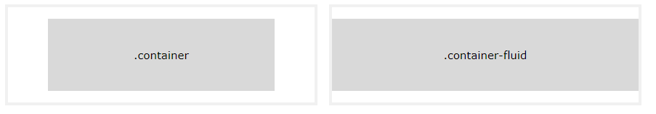
Contenedores
container: Proporciona un contenedor responsive ajustado al ancho.
container-fluid: Proporciona un contenedor de ancho 100%. Toda la pantalla.
Ej:
<div class="container"> <h1>Creando container…</h1> </div>

Slide 11
Tipografía
Alineación:
text-left→ text-center → text-right → text-justify
Fuente:
font-italic
font-weight-bold →Font-weight-light
Otros:
text-capitalize → text-uppercase

Slide 12
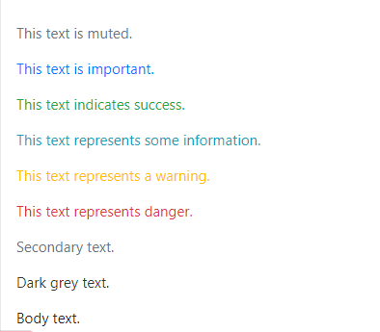
Colores
Color del texto:
text-muted, text-primary, text-success, text-info, text-warning, text-danger,
text-secondary, text-white, text-dark, text-body and text-light
Opacidad → text-black-50

Slide 13
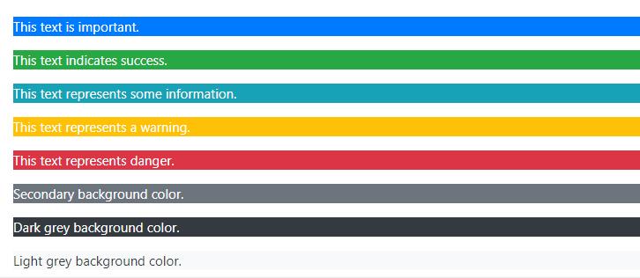
Colores
Color de fondo:
bg-primary, bg-success, bg-info, bg-warning, bg-danger, bg-secondary, bg-dark, bg-light.

Slide 14
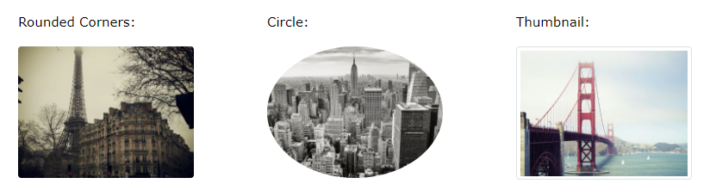
Imágenes
rounded → rounded-circle → img-thumbnail
Ej:
<img src=“perro.jpg" class="rounded" alt=“Perro">

Slide 15
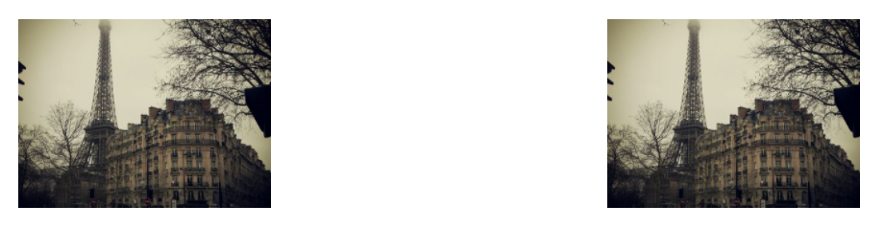
Alineación de las imágenes
float-right → float-left
Ej:
<img src="paris.jpg" class="float-left"> <img src="paris.jpg" class="float-right">

Slide 16
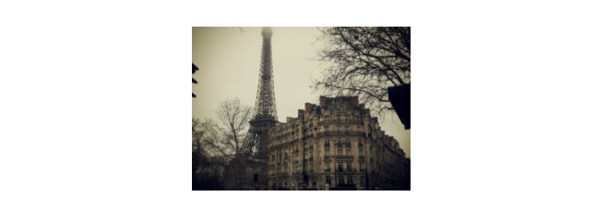
Imágenes centradas
mx-auto
<img src="paris.jpg" class="mx-auto d-block">
img-fluid → Se ajusta al 100% responsive.
<img class="img-fluid" src="img_chania.jpg" alt="Chania">

Slide 17
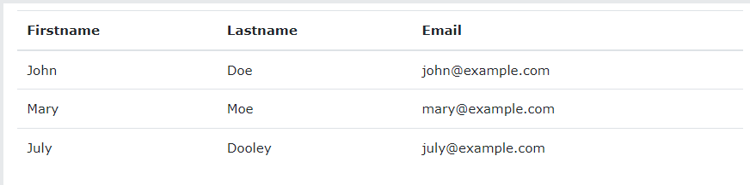
Tablas
table

Slide 18
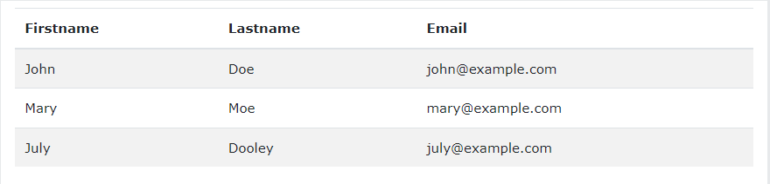
Tablas
table-striped
table-hover

Slide 19
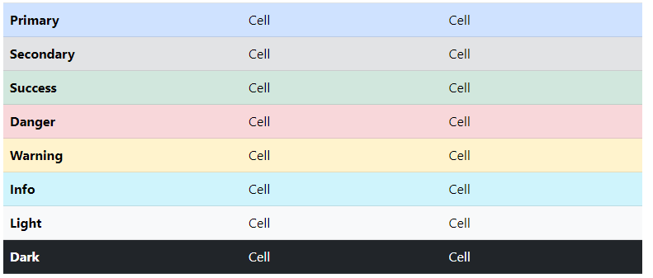
Tablas de colores
table-primary

Slide 20
Botones
<button type="button" class="btn">Basic</button> <button type="button" class="btn btn-primary">Primary</button> <button type="button" class="btn btn-secondary">Secondary</button> <button type="button" class="btn btn-success">Success</button> <button type="button" class="btn btn-info">Info</button> <button type="button" class="btn btn-warning">Warning</button> <button type="button" class="btn btn-danger">Danger</button> <button type="button" class="btn btn-dark">Dark</button> <button type="button" class="btn btn-light">Light</button> <button type="button" class="btn btn-link">Link</button>

Slide 21
Botones
<button type="button" class="btn btn-outline-primary">Primary</button> <button type="button" class="btn btn-outline-secondary">Secondary</button> <button type="button" class="btn btn-outline-success">Success</button> <button type="button" class="btn btn-outline-info">Info</button> <button type="button" class="btn btn-outline-warning">Warning</button> <button type="button" class="btn btn-outline-danger">Danger</button> <button type="button" class="btn btn-outline-dark">Dark</button> <button type="button" class="btn btn-outline-light text-dark">Light</button>

Slide 22

Botones Dropdowns
<div class="dropdown"> <button type="button" class="btn btn-primary dropdown-toggle" data-toggle="dropdown"> Dropdown button </button> <div class="dropdown-menu"> <a class="dropdown-item" href="#">Link 1</a> <a class="dropdown-item" href="#">Link 2</a> <a class="dropdown-item" href="#">Link 3</a> </div> </div>

Slide 23

Tamaño de botones
<button type="button" class="btn btn-primary btn-lg">Large</button> <button type="button" class="btn btn-primary">Default</button> <button type="button" class="btn btn-primary btn-sm">Small</button>
btn-block
<button type="button" class="btn btn-primary btn-block">Full-Width Button</button>

Slide 24

botones Spinner
<button class="btn btn-primary"> <span class="spinner-border spinner-border-sm"></span> </button> <button class="btn btn-primary"> <span class="spinner-border spinner-border-sm"></span> Loading.. </button> <button class="btn btn-primary" disabled> <span class="spinner-border spinner-border-sm"></span> Loading.. </button> <button class="btn btn-primary" disabled> <span class="spinner-grow spinner-grow-sm"></span> Loading.. </button>

Slide 25

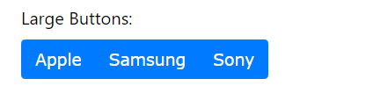
Grupo de botones
<div class="btn-group"> <button type="button" class="btn btn-primary">Apple</button> <button type="button" class="btn btn-primary">Samsung</button> <button type="button" class="btn btn-primary">Sony</button> </div>
<div class="btn-group btn-group-lg"> <button type="button" class="btn btn-primary">Apple</button> <button type="button" class="btn btn-primary">Samsung</button> <button type="button" class="btn btn-primary">Sony</button> </div>

Slide 26

Etiqueta
Dentro de etiqueta span
<h1>Example heading <span class="badge badge-secondary">New</span></h1> <h2>Example heading <span class="badge badge-secondary">New</span></h2> <h3>Example heading <span class="badge badge-secondary">New</span></h3> <h4>Example heading <span class="badge badge-secondary">New</span></h4> <h5>Example heading <span class="badge badge-secondary">New</span></h5> <h6>Example heading <span class="badge badge-secondary">New</span></h6>
<span class="badge badge-primary">Primary</span> <span class="badge badge-secondary">Secondary</span> <span class="badge badge-success">Success</span> <span class="badge badge-danger">Danger</span>

Slide 27
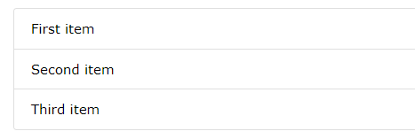
Listas
<ul class="list-group"> <li class="list-group-item">First item</li> <li class="list-group-item">Second item</li> <li class="list-group-item">Third item</li> </ul>

Slide 28
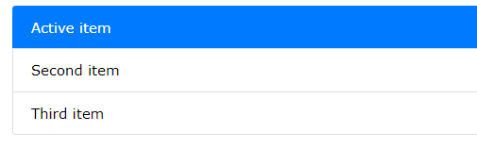
Listas
<ul class="list-group"> <li class="list-group-item active">Active item</li> <li class="list-group-item">Second item</li> <li class="list-group-item">Third item</li> </ul>

Slide 29

Listas horizontales
<ul class="list-group list-group-horizontal"> <li class="list-group-item">First item</li> <li class="list-group-item">Second item</li> <li class="list-group-item">Third item</li> <li class="list-group-item">Fourth item</li> </ul>

Slide 30
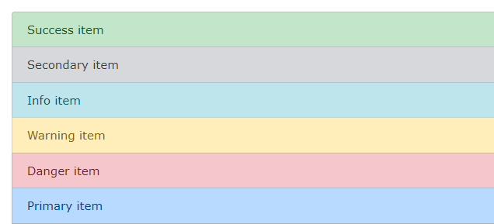
Lista de colores
<ul class="list-group"> <li class="list-group-item list-group-item-success">Success item</li> <li class="list-group-item list-group-item-secondary">Secondary item</li> <li class="list-group-item list-group-item-info">Info item</li> <li class="list-group-item list-group-item-warning">Warning item</li> <li class="list-group-item list-group-item-danger">Danger item</li> <li class="list-group-item list-group-item-primary">Primary item</li> <li class="list-group-item list-group-item-dark">Dark item</li> <li class="list-group-item list-group-item-light">Light item</li> </ul>

Slide 31
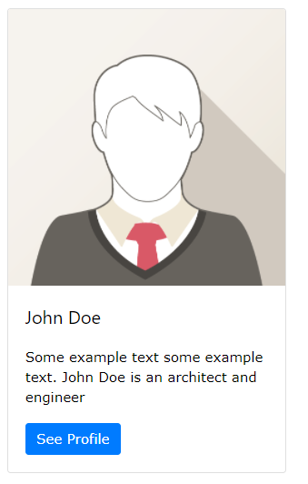
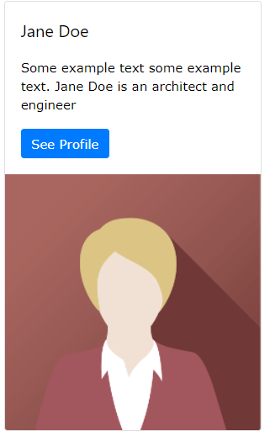
Cards
card-img-top // card-img-bottom
<div class="card" style="width:400px"> <img class="card-img-top" src="img_avatar1.png" alt="Card image"> <div class="card-body"> <h4 class="card-title">John Doe</h4> <p class="card-text">Some example text.</p> <a href="#" class="btn btn-primary">See Profile</a> </div> </div>

Slide 32
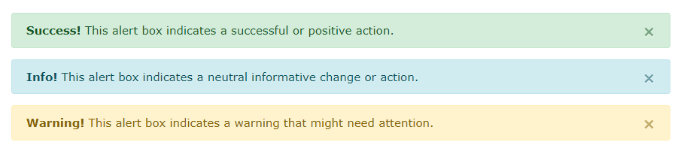
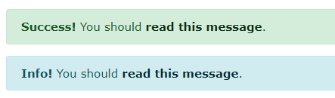
Alertas
<div class="alert alert-success"> <strong>Success!</strong> Indicates a successful or positive action. </div>
alert-link
<div class="alert alert-success"> <strong>Success!</strong> You should <a href="#" class="alert-link">read this message</a>. </div>

Slide 33
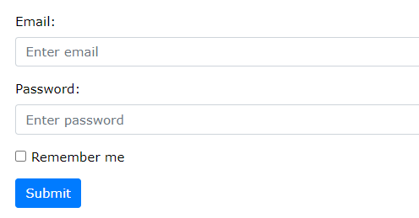
Formularios
<form action="/action_page.php"> <div class="form-group"> <label for="email">Email address:</label> <input type="email" class="form-control" placeholder="Enter email" id="email"> </div> <div class="form-group"> <label for="pwd">Password:</label> <input type="password" class="form-control" placeholder="Enter password" id="pwd"> </div> <div class="form-group form-check"> <label class="form-check-label"> <input class="form-check-input" type="checkbox"> Remember me </label> </div> <button type="submit" class="btn btn-primary">Submit</button> </form>

Slide 34
Formularios inline
<form class="form-inline" action="/action_page.php"> <label for="email" class="mr-sm-2">Email address:</label> <input type="email" class="form-control mb-2 mr-sm-2" placeholder="Enter email" id="email"> <label for="pwd" class="mr-sm-2">Password:</label> <input type="password" class="form-control mb-2 mr-sm-2" placeholder="Enter password" id="pwd"> <div class="form-check mb-2 mr-sm-2"> <label class="form-check-label"> <input class="form-check-input" type="checkbox"> Remember me </label> </div> <button type="submit" class="btn btn-primary mb-2">Submit</button> </form>

Slide 35
